Slide 1



CSE422 : ARTIFICIAL INTELLIGENCE
Structure OF AGENTS
BY
BENJIR ISLAM ALVEE

Slide 2
How do you design an intelligent agent?
Definition: An intelligent agent perceives its environment via sensors and acts rationally upon that environment with its actuators.
A discrete agent receives percepts one at a time, and maps this percept sequence to a sequence of discrete actions.
Properties
Autonomous
Reactive to the environment
Pro-active (goal-directed)
Interacts with other agents via the environment

Slide 3





AGENTS

Slide 4
Sensors/Percepts and Actuators/Actions
Humans
Sensors: Eyes (vision), ears (hearing), skin (touch), tongue (gustation), nose (olfaction), neuromuscular system (proprioception)
Percepts:
At the lowest level – electrical signals from these sensors
After preprocessing – objects in the visual field (location, textures, colors, …), auditory streams (pitch, loudness, direction), …
Actuators: limbs, digits, eyes, tongue, …
Actions: lift a finger, turn left, walk, run, carry an object, …
The Point: percepts and actions need to be carefully defined, possibly at different levels of abstraction

Slide 5
TYPES OF AGENT
Table-driven agents
use a percept sequence/action table in memory to find the next action. They are implemented by a (large) lookup table.
Simple reflex agents
are based on condition-action rules, implemented with an appropriate production system. They are stateless devices which do not have memory of past world states.
Agents with memory(model/knowledge)
have internal state, which is used to keep track of past states of the world.
Agents with goals
are agents that, in addition to state information, have goal information that describes desirable situations. Agents of this kind take future events into consideration.
Utility-based agents
base their decisions on classic axiomatic utility theory in order to act rationally.

Slide 6
Table-driven agents
Table lookup of percept-action pairs mapping from every possible perceived state to the optimal action for that state
Problems
Too big to generate and to store (Chess has about 10¹⁵⁰ states, for example)
No agent could ever learn all the right table entries from its experience
No guidance about how to fill in the table entries
Not adaptive to changes in the environment; requires entire table to be updated if changes occur
Looping: Can’t make actions conditional on previous actions/states

Slide 7
Simple reflex agents
Immediate or spontaneous action
Do not check past record
Based on current state
Based on If-Then rule
Problems
Too big table to generate and to store
Do not work for partially observable environment
Do not involve multiple condition
No knowledge of non-perceptual parts of state
Not adaptive to environment change; requires collection of rules to be updated if changes occur
Can’t make actions conditional on previous state

Slide 8
Architecture of Simple reflex agent architecture

Slide 9
Example: Vacuum Cleaner

Slide 10
Simple Function
Percept Sequence Action
[A, Clean] Right
[A, Dirty] Suck
[B, Clean] Left
[B, Dirty] Suck
[A, Clean], [A, Clean] Right
[A, Clean], [A, dirty] Suck
…
…
[A, Clean], [A, Clean], [A, Dirty] Suck

Slide 11
Model-based Agents
Knowledge based
Store percept history
Partially observable environment
Adaptive ability to environment change

Slide 12
Architecture for a model-based agent

Slide 13
Automated taxi driving system
Percepts: Video, sonar, speedometer, odometer, engine sensors, keyboard input, microphone, GPS, …
Actions: Steer, accelerate, brake, horn, speak/display, …
Goals: Maintain safety, reach destination, maximize profits (fuel, tire wear), obey laws, provide passenger comfort, …
Environment: Urban streets, freeways, traffic, pedestrians, weather, customers, …

Slide 14
Goal-based agent
Expansion of model based agent
Choose actions so as to achieve a desired goal
Keeping track of the current state and past state are not enough − need to add goals to decide which situations are good
Searching and Planning
Deliberative instead of reactive.
May have to consider long sequences of possible actions before deciding if goal is achieved – involves consideration of the future, “what will happen if I do...?”

Slide 15
Architecture for goal-based agent

Slide 16
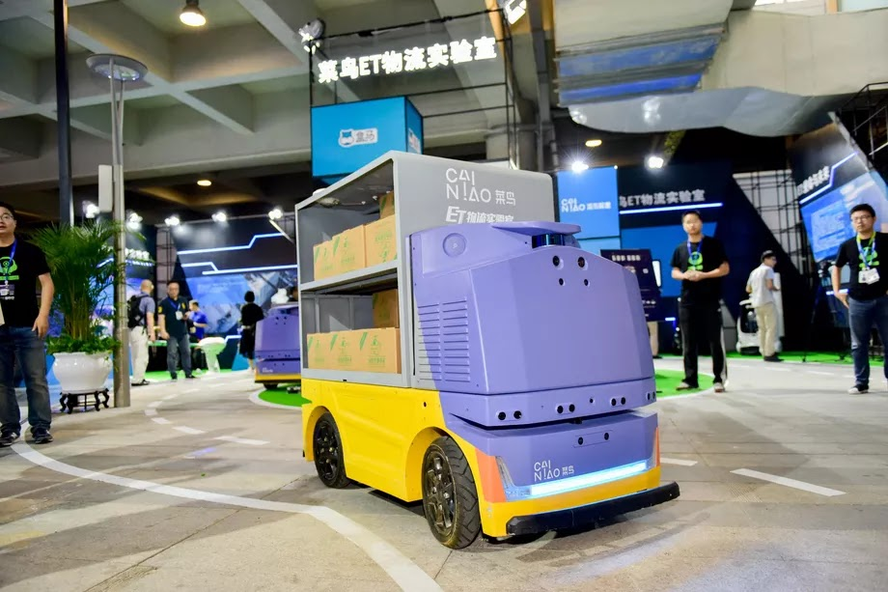
G+ Robot by Alibaba Company

Slide 17
Utility-based agents
When there are multiple possible alternatives, how to decide which one is best?
Focuses on utility or degree of happiness
Utility function U: State → Reals indicating a measure of success or happiness when at a given state
Allows decisions comparing choice between conflicting goals, and choice between likelihood of success and importance of goal (if achievement is uncertain)
Example: Mars Lander on the surface of mars with obstacle in its way; utility function will direct it to choose best path for best output

Slide 18
Architecture for a complete utility-based agent

Slide 19

Thank You!

